Slide 1
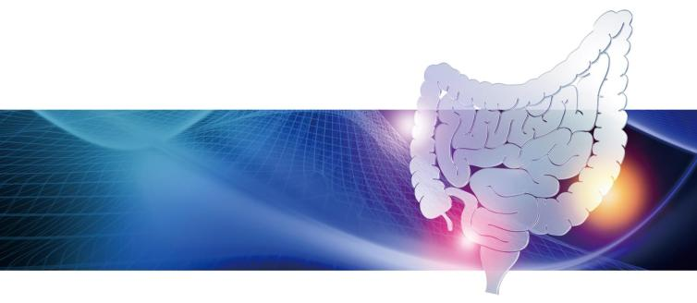
the 10th Annual Meeting of the Asian Organization for Crohn’s and Colitis
AOCC2022
Morning Seminar 2
Time ＆
Date
8:00-8:50 Friday, June 17,2022
IBD New Topics in Japan
Chair
Ryuichi Okamoto
(Tokyo Medical and Dental University, Tokyo, Japan)
Lecture 1
IBD Monitoring Topics
Kento Takenaka
(Tokyo Medical and Dental University, Tokyo, Japan)
Lecture ２
UC Treatment Topics
Taku Kobayashi
(Kitasato University Kitasato Institute Hospital, Tokyo, Japan)
EA Pharma Co.,Ltd./SEKISUI MEDICAL CO., Ltd./AOCC2022

